Slide 1
Impact of aviation on Cirrus Cloud Formation within European airspace - Update V
Timothy van der Duim
Student Climate Physics

Slide 2
Cirrus data project
Progress made
Some improvements on time series analysis
RF model evaluation
Validation METEOSAT data
Started analyzing METEOSAT data vs ATD

Slide 3
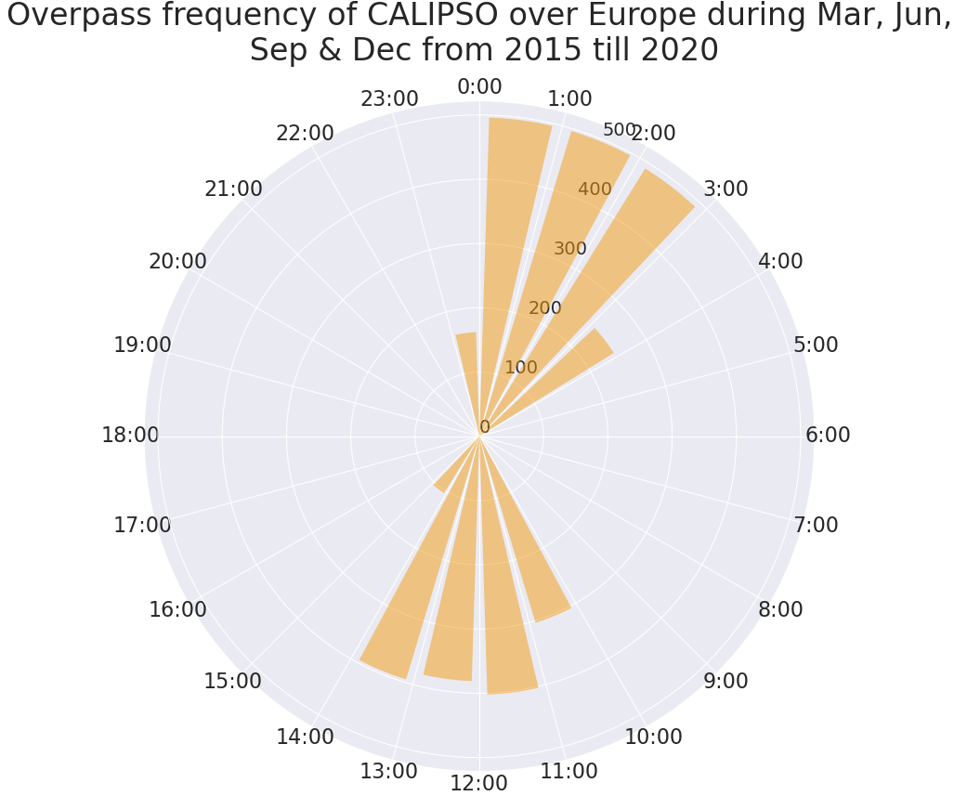
Cirrus data project
Temporal coverage
CALIPSO – All months
Overpasses mostly after midnight and around noon
Times shown is UTC time
What is the difference in cover between day and night?

Slide 4
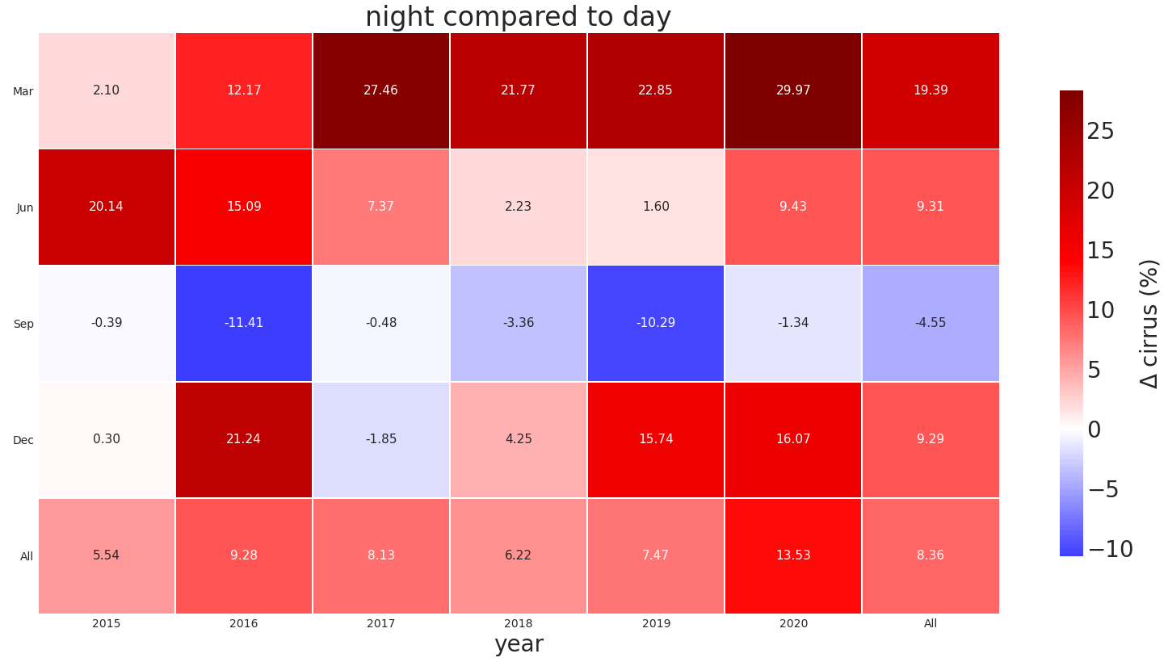
Cirrus data project
Night cover vs day
Nightly cirrus cover vs cover during the day
Generally higher cover during the night -> what happens in September?

Slide 5
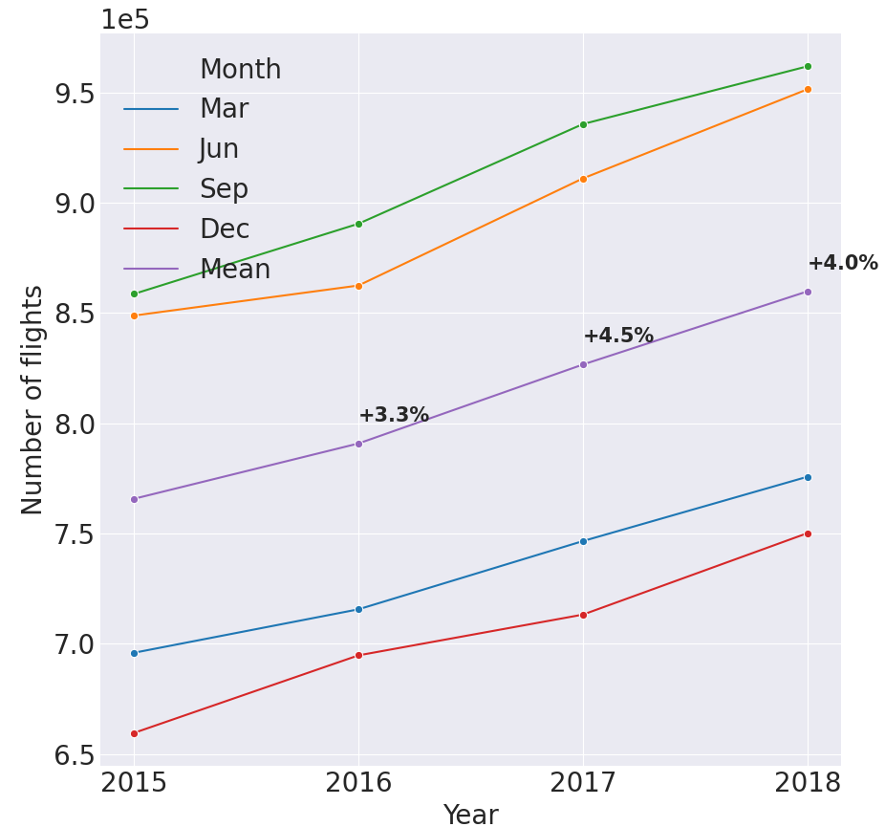
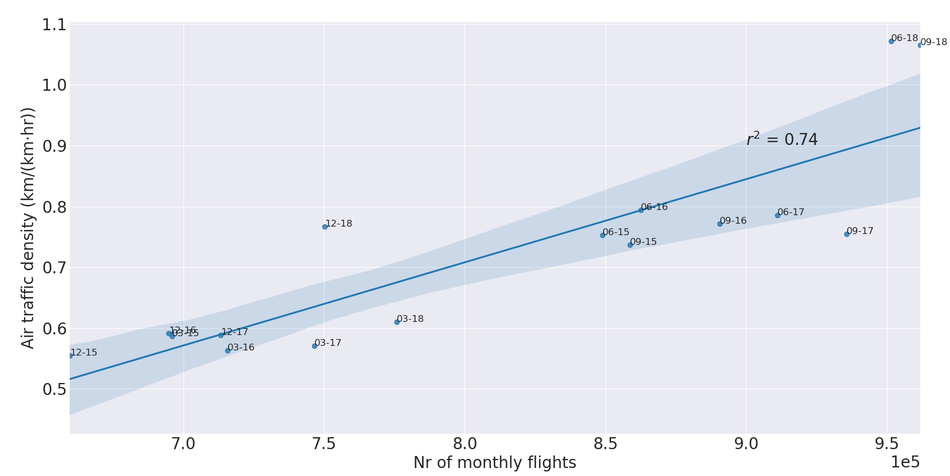
Cirrus data project
What about air traffic?
Clearly upgoing trend -> consistent with literature
Strong (expected) correlation ATD and nr of monthly flights

Slide 6
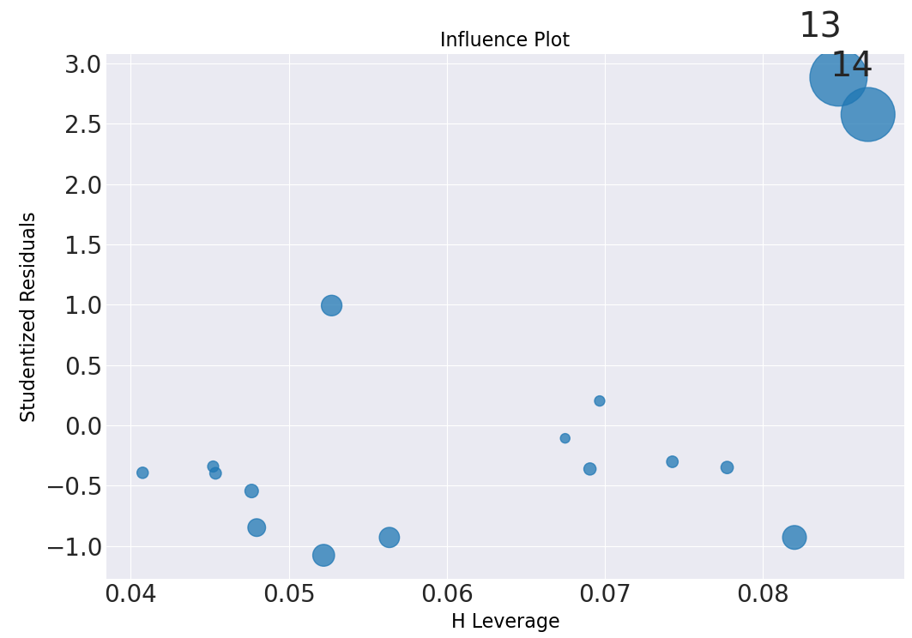
Cirrus data project
Air traffic data

Slide 7
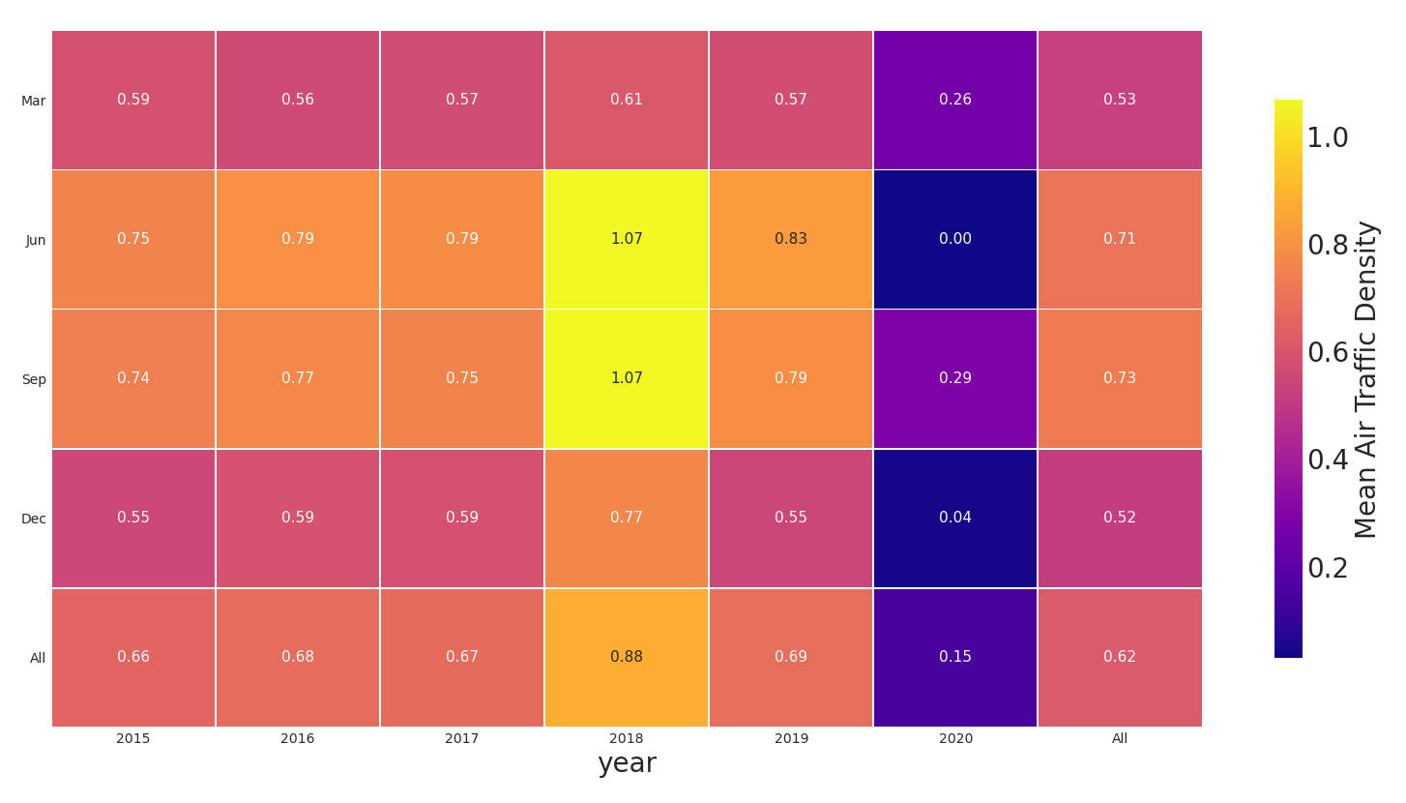
Cirrus data project
Air traffic data
How representative are the samples for entire month? (anomalies in June and Sep 2018?)
2019 and 2020 obtained from linreg model
How accurate are number of flights from algorithm in 2019 & 2020?
From algorithm: 696,444 flights
From newly released datasets: 781,966 flights in March 2019
Underestimation of 11%

Slide 8

Cirrus data project
Flight dataset from Zenodo – Mar 2019

Slide 9
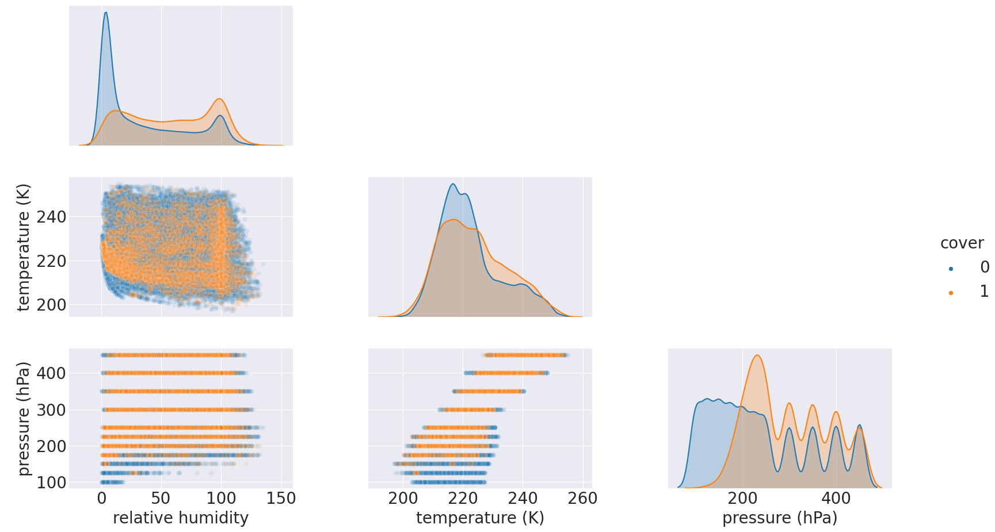
Cirrus data project
How can we explain cirrus variance?
Test data (50% of Jan 2015 data)

Slide 10
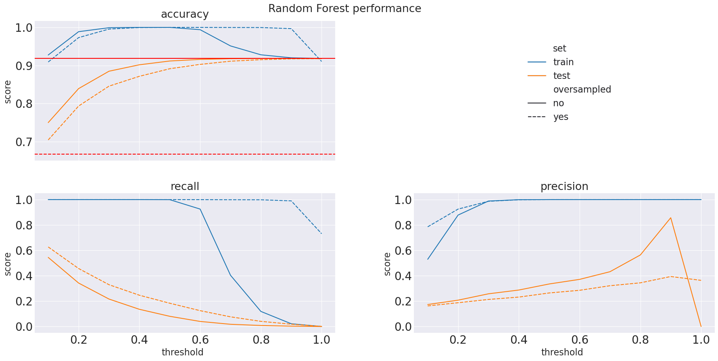
Cirrus data project
Performance RF model
Results on test data disappointing!
Oversampling does not improve test performance in general

Slide 11
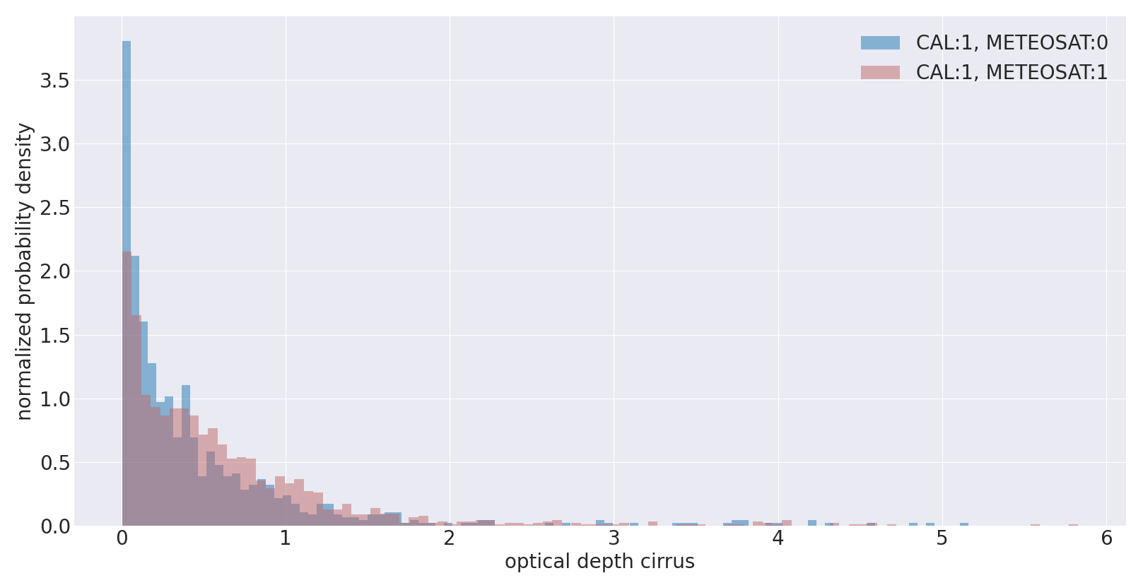
 | No cirrus (CALIPSO) | Cirrus (CALIPSO) | Total
No cirrus (METEOSAT) | 2647 | 897 | 3544
Cirrus (METEOSAT) | 997 | 1589 | 2586
Total | 3644 | 2486 | 6130
Cirrus data project
METEOSAT validation
Benefit from high sensing frequency METEOSAT
But accurate enough? (passive sensor)

Slide 12
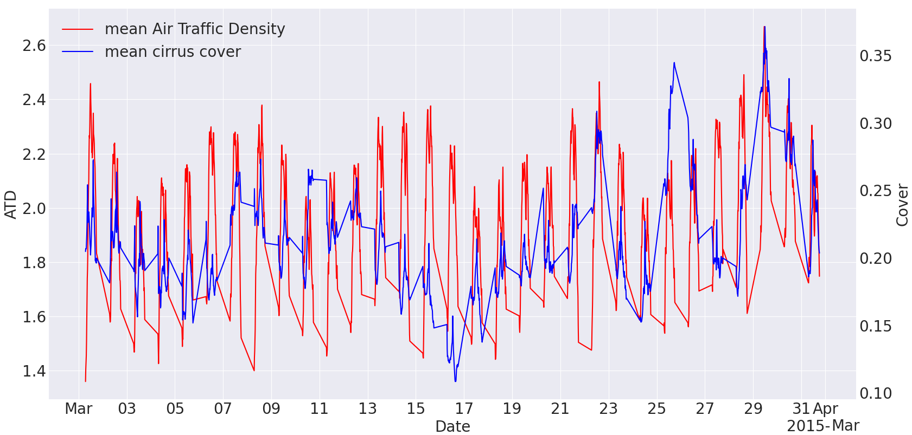
Cirrus data project
METEOSAT analysis
Use one month (March 2015)
Air traffic data fully interpolated! (nearly 10M datapoints)
Strategy: bin cells based on Temp, RH & Pres.lvl?
Within those bins, sample on air traffic density? (Mannstein & Ulrich paper, 2005)

